Slide 1

Data Visualization (0602344) Submitted To: Dr. Rasha Al-bashaireh
Fall Semester-
2023/2024
final Project Presentation
College of Information Technology and Communication

Slide 2
Worldwide Average IQ Levels
GROUP #: 6 GROUP MEMBERS NAMES: Amer Samamh, Sami Sadaqa, Laith Saleh

Slide 3

Dataset Description
Explore the "Worldwide Average IQ Levels and Socioeconomic Factors Dataset" to gain insights into the intelligence quotient (IQ) levels of different countries and their related socioeconomic factors.
The general results of:
dataframe.shape

Slide 4
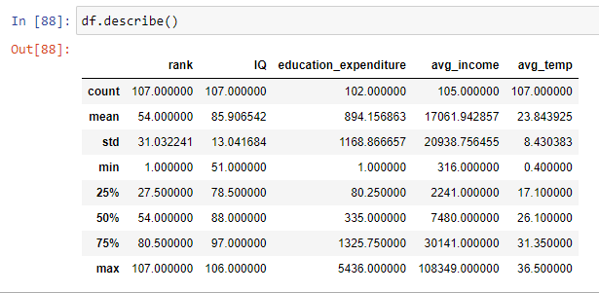
Dataset Description
The general results of:
dataframe.describe()

Slide 5
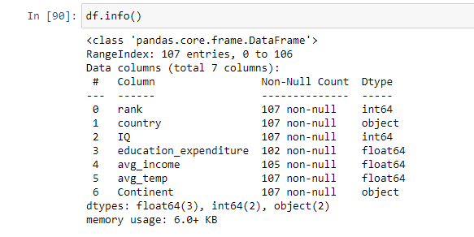
Dataset Description
The general results of:
dataframe.info()

Slide 6
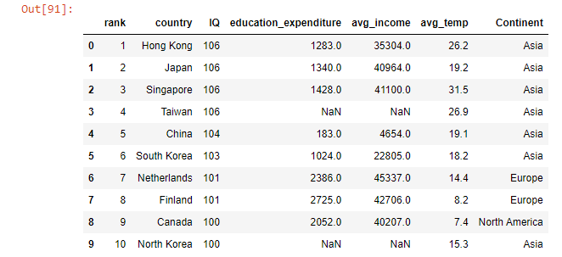
Dataset Sample Snapshot

Slide 7
Dataset Visualizations Demo
Demonstrate the visualization(3-4 figures) of your dataset to the class using a simple task or a project demo.
Go to Demo(run the jupyter file)

Slide 8
References
https://www.kaggle.com/datasets/abhijitdahatonde/worldwide-average-iq-levels

Slide 9
Questions ?

